Slide 1
3D DETECTION: From CV Class to Application From 2D to 3D
CS 1803 邢广杰

Slide 2
CONTENTS
01
02
03
INTRODUCTION
PROCESS
FUTURE DIRECTIONS
Why and how I do this work
What I want to figure out.
What I have done in this project
What can I do in the future

Slide 3
INTRODUCTION
01

Slide 4
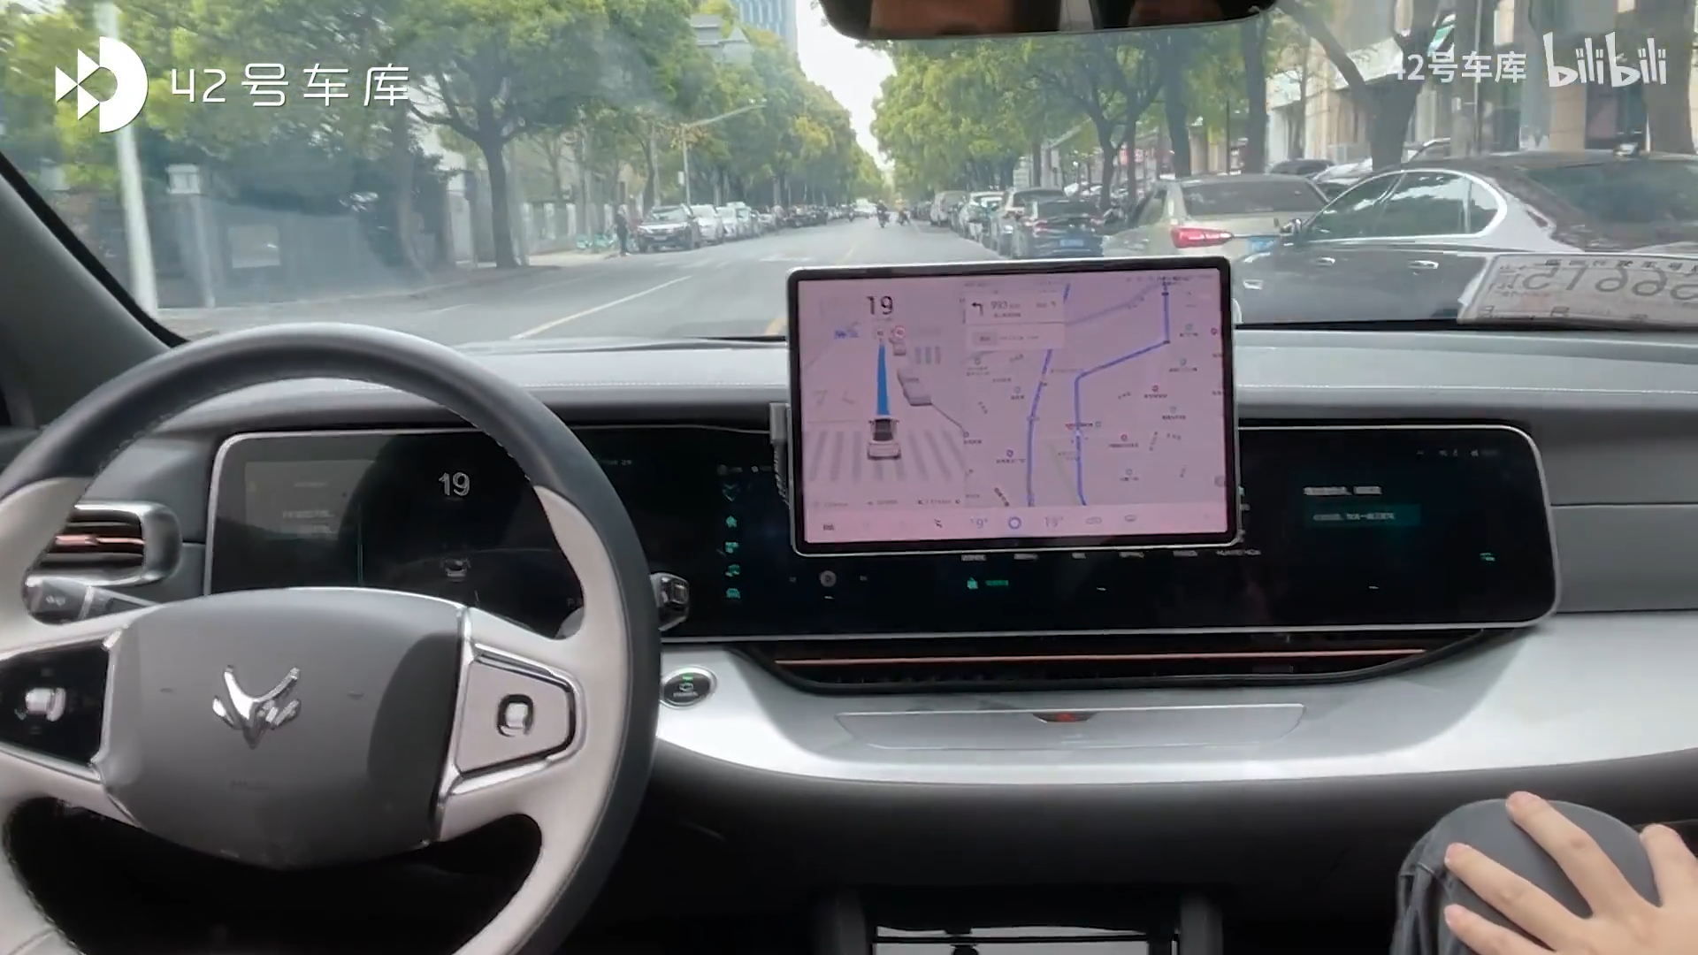
Huawei’s self-driving tech
I can’t understand but I was shocked!

Slide 5
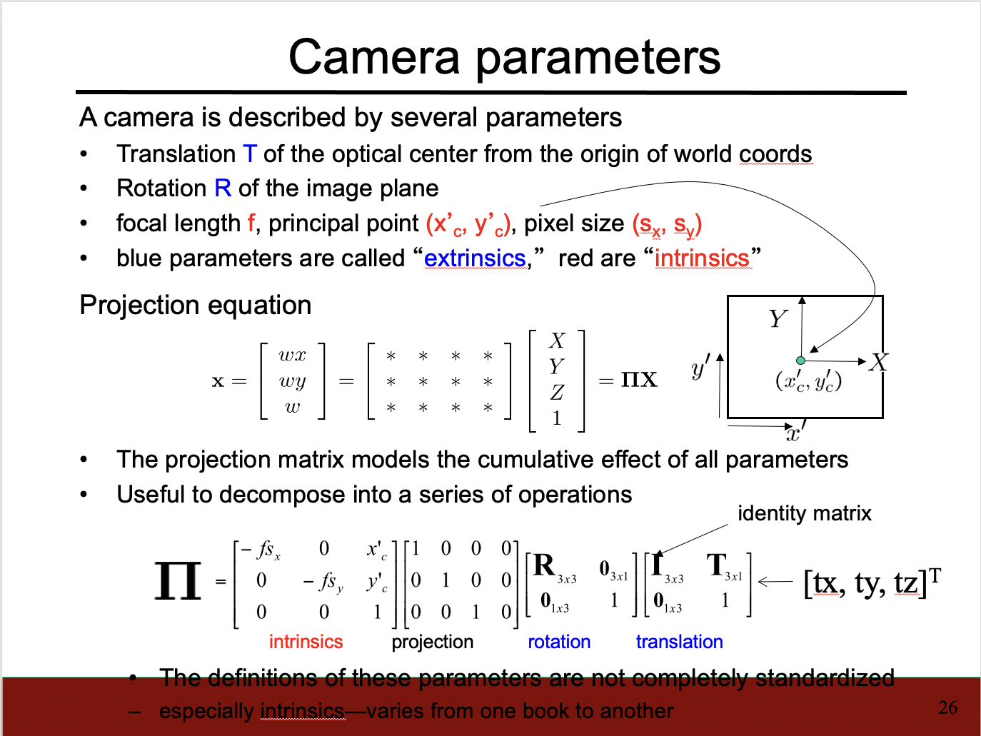
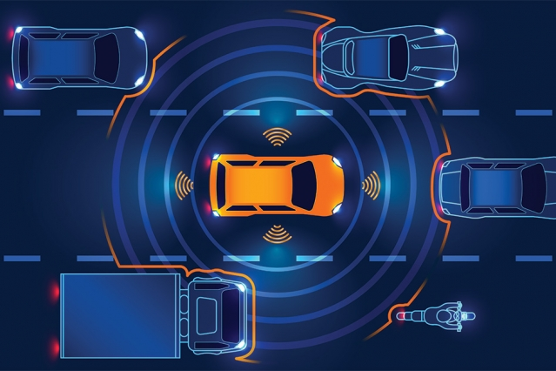
MY QUESTION
What I learned in CV class
How industry implement
Camara parameters
Perspective projection
LiDAR tech
Powerful mathematics…

Slide 6
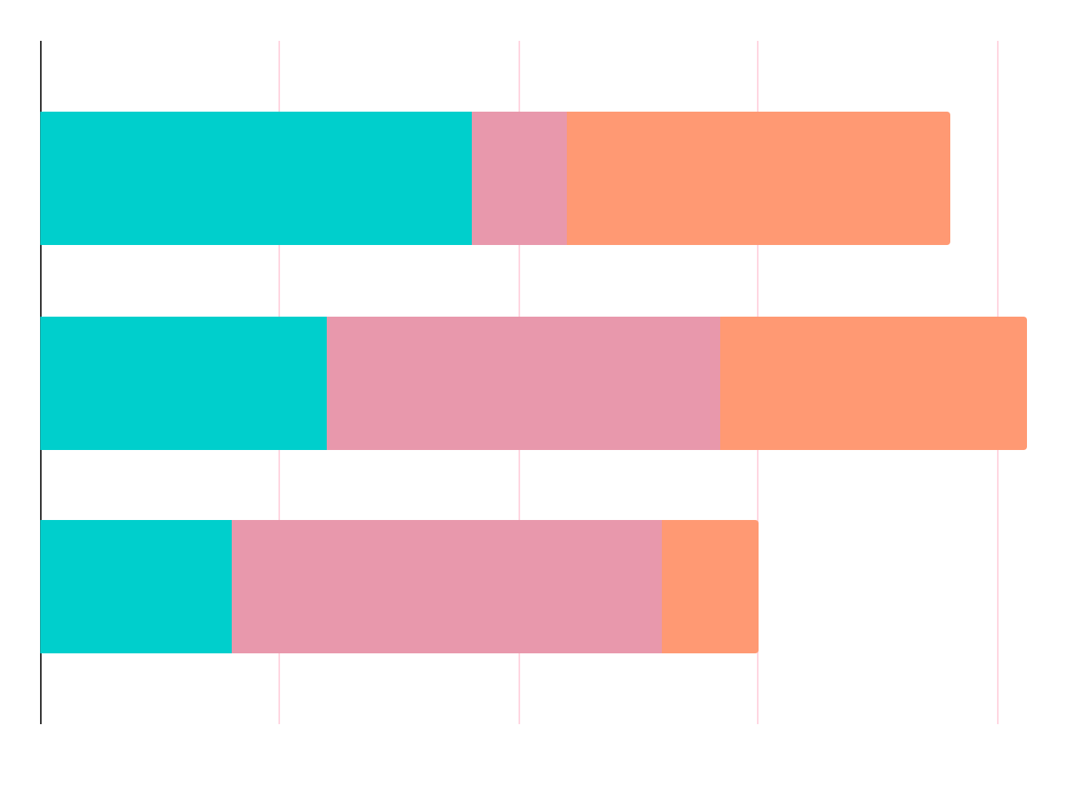
CURRENT RESEARCH
Front view image based Bird’s eye view based 3D based
LiDAR Monocular camera Both

Slide 7
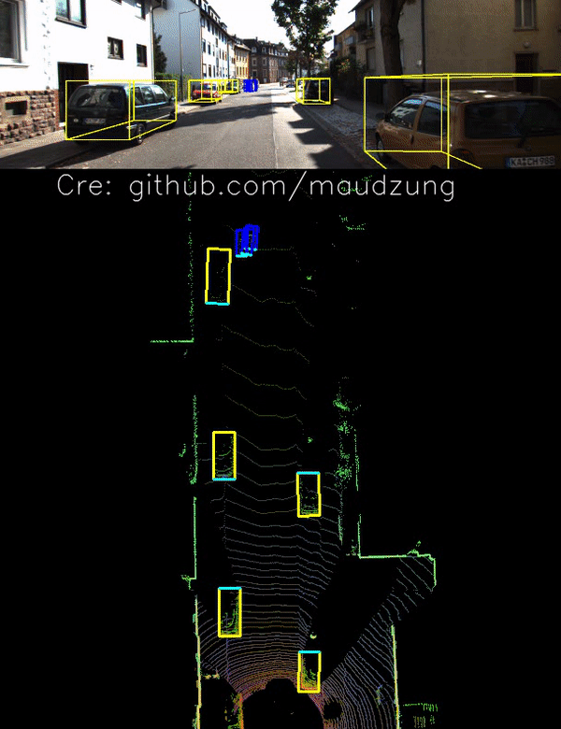
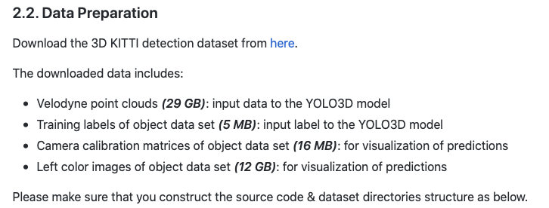
LiDAR + BEV
40 FPS on Titan X GPU
PAPER:
YOLO3D: End-to-end real-time 3D Oriented Object Bounding Box Detection from LiDAR Point Cloud

Slide 8
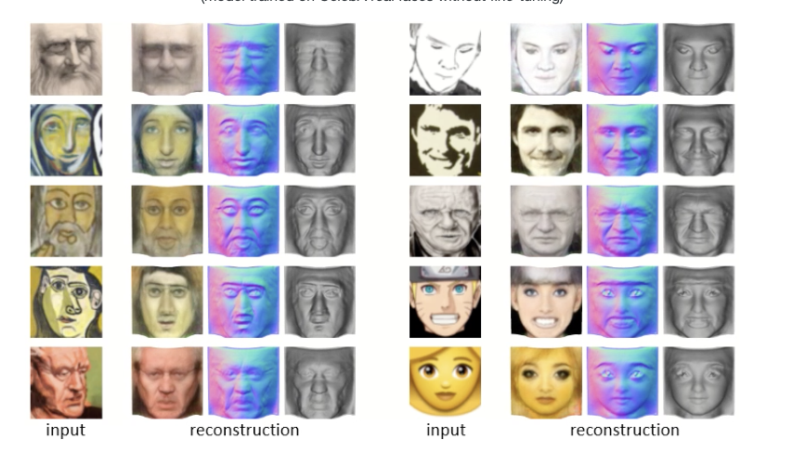
So mush complex! Can we make things easier?🤔
CVPR 2020 Best Paper: Unsupervised Learning of Probably Symmetric Deformable 3D Objects from Images in the Wild
Yeah! We can do 2D to 3D

Slide 9
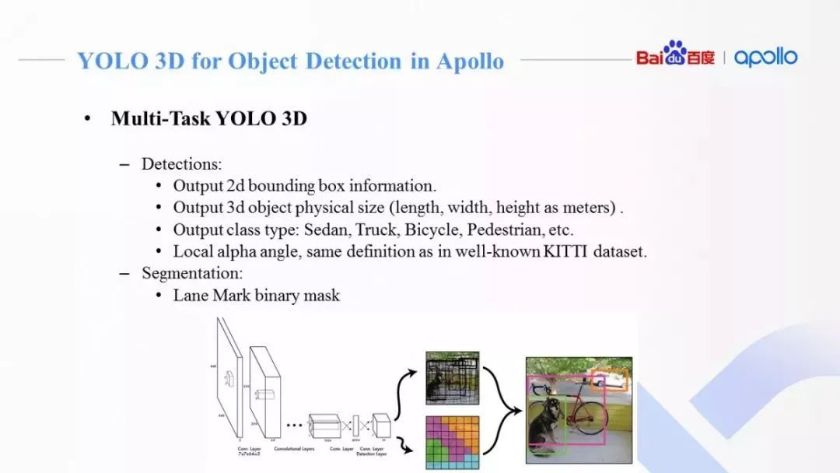
Baidu Apollo: YOLO 3D for Object Detection in Apollo
Decoder:
Detection + Segmentation

Slide 10
What if we can simplify it more?
3D Bounding Box Estimation Using Deep Learning and Geometry , CVPR 2017
Regress to estimate √
Geometric constraints √
Preprocessing stage ×
3D object models ×
Stereo ×
2D -> 3D !
Object Detection !
Deep Learning!
Course Knowledge Involved !
That’s it✌️

Slide 11
PROCESS
02

Slide 12
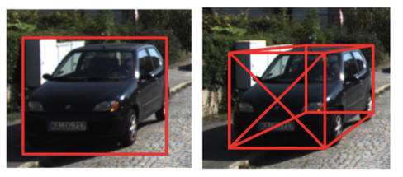
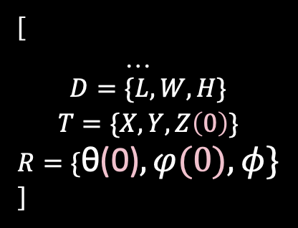

From 2D detection to 3D detection: Bounding Box
Yolo for example:
[
[$P_{i}…],$
$$confidence,$$
$${[X, Y, w,h]}^{T}$$
]
[
…
$$\begin{aligned}D=\{L, W, H\} \\ T=\{X, Y, Z\left(0\right)\} \\ R=\{\text{θ}\text{(0)}, φ(0), φ\}\end{aligned}$$
]
Whatever, we do classification + regression

Slide 13

What to regress?
3D point $X_{0}=\left[X, Y, Z, 1\right]$
Point in image $x=\left[x, y, 1\right]$
$$x=K\left[R T\right]X_{0}$$
(Camara & Perspective projection)

Slide 14
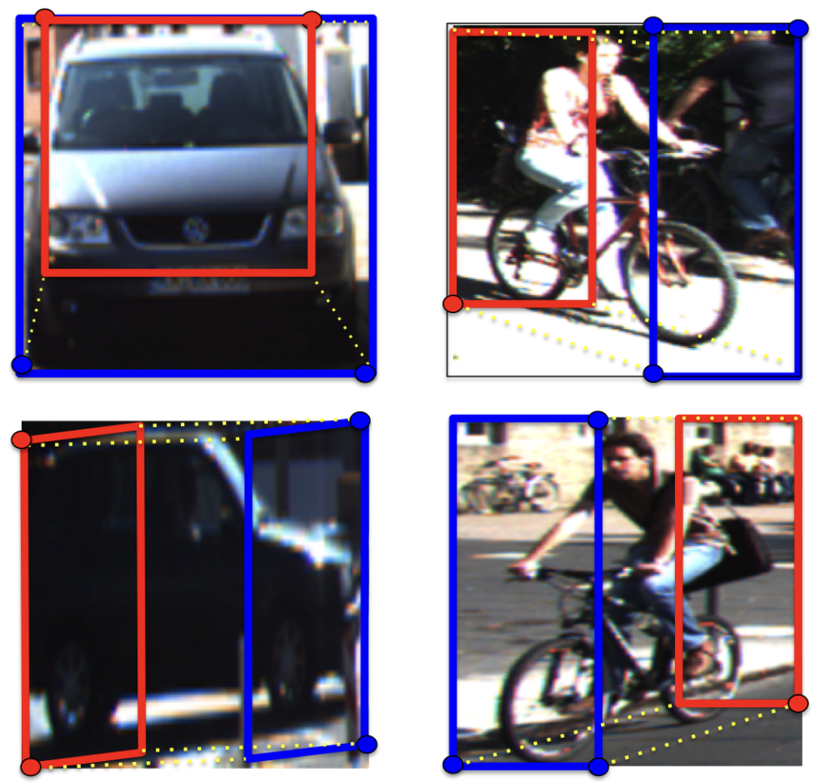
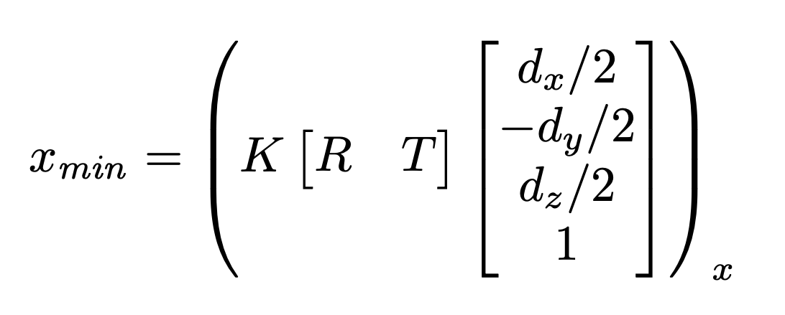
What to regress?
Assume:
Each side of the 2D bounding box to be touched by the projection of at least one of the 3D box conners
Geometric constraints: 4 at most
But we have 9 DoF
Orientation have a strong effect(R)
Smaller variance parameter(D’s residual)

Slide 15
In total
2D Bounding Box Detector(MS-CNN in paper, pretrained YOLO in mine)
+
Object Pose Estimation(regression with resized VGG19.features as input)
+
3D Central Point Decoder(in math with 2D bbox, regressed value and camera calibration using OLS)
+
Plot Utils

Slide 16
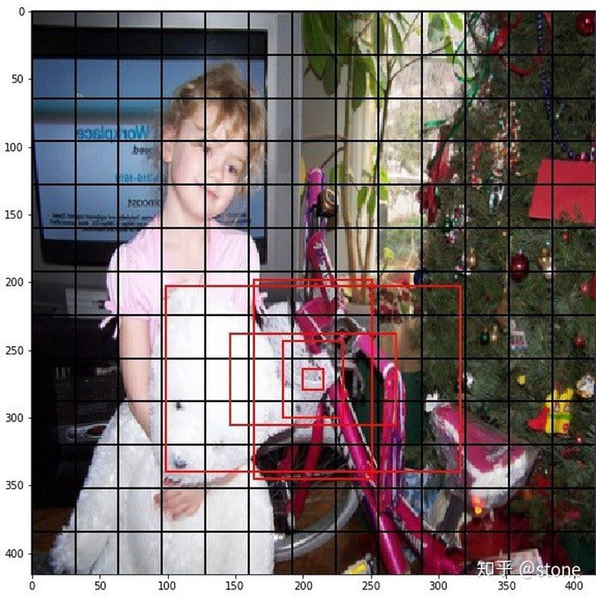
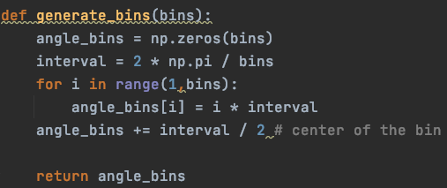
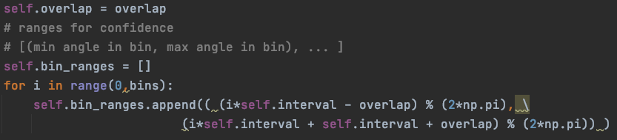
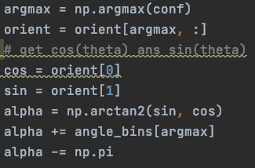
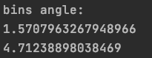
Estimation Strategy: Multibin
Anchor in YOLO:
Multibin(nums and overlap as hyper para):

Slide 17
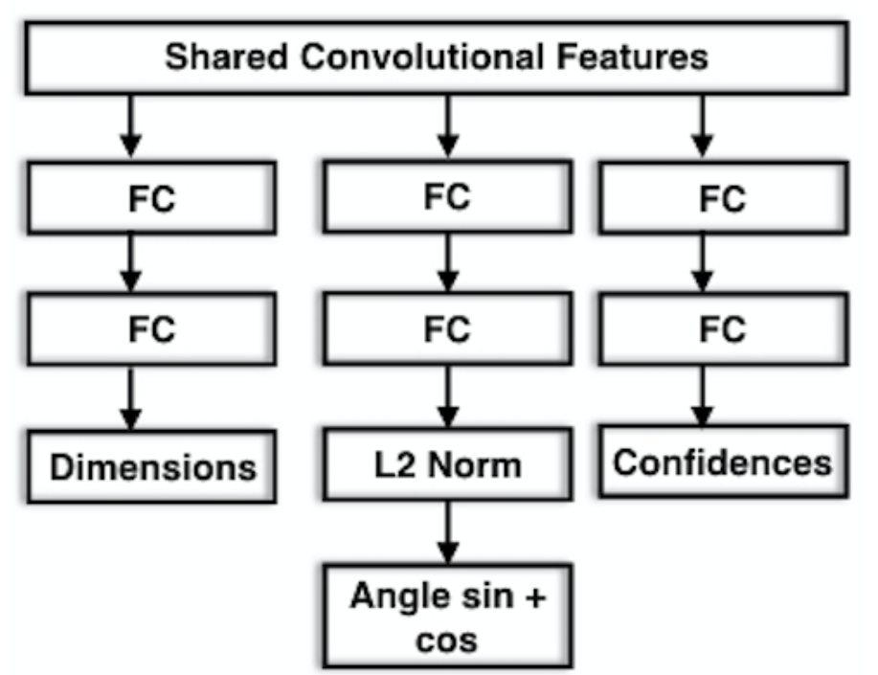
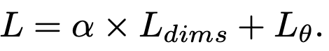
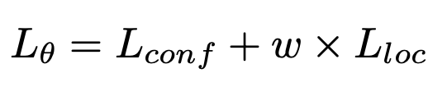
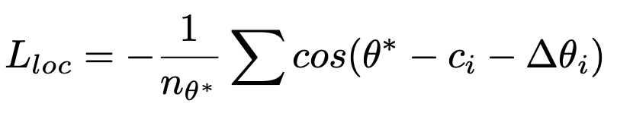
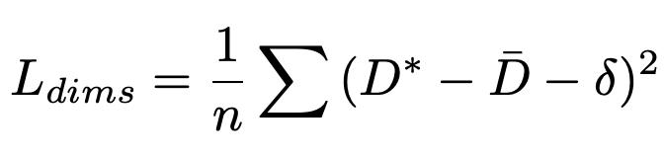
Object Object Pose Estimation – what we train
Loss function:
Optimizer:
SGD

Slide 18
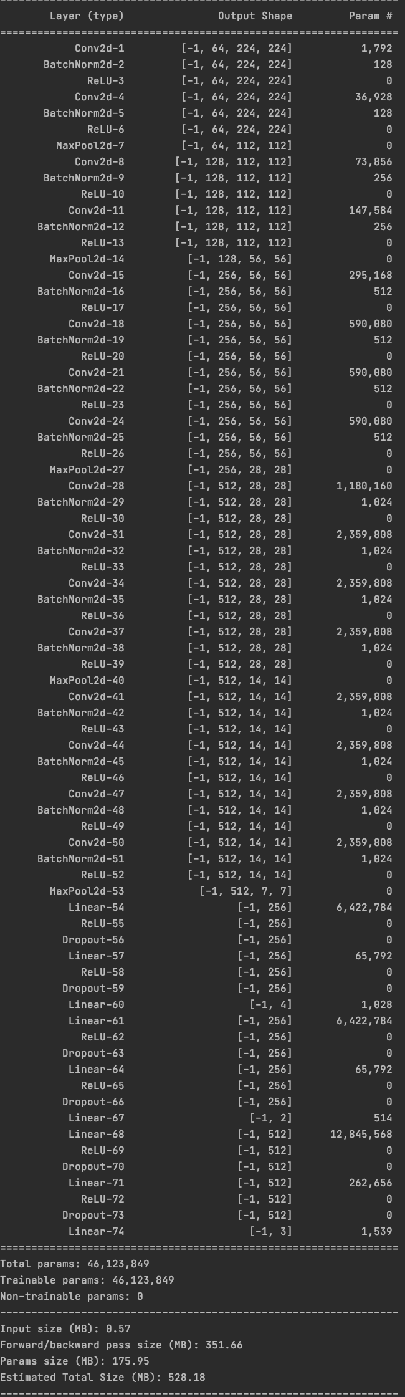
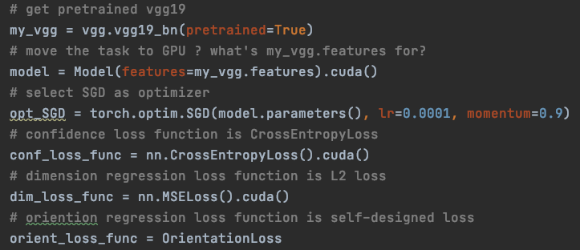
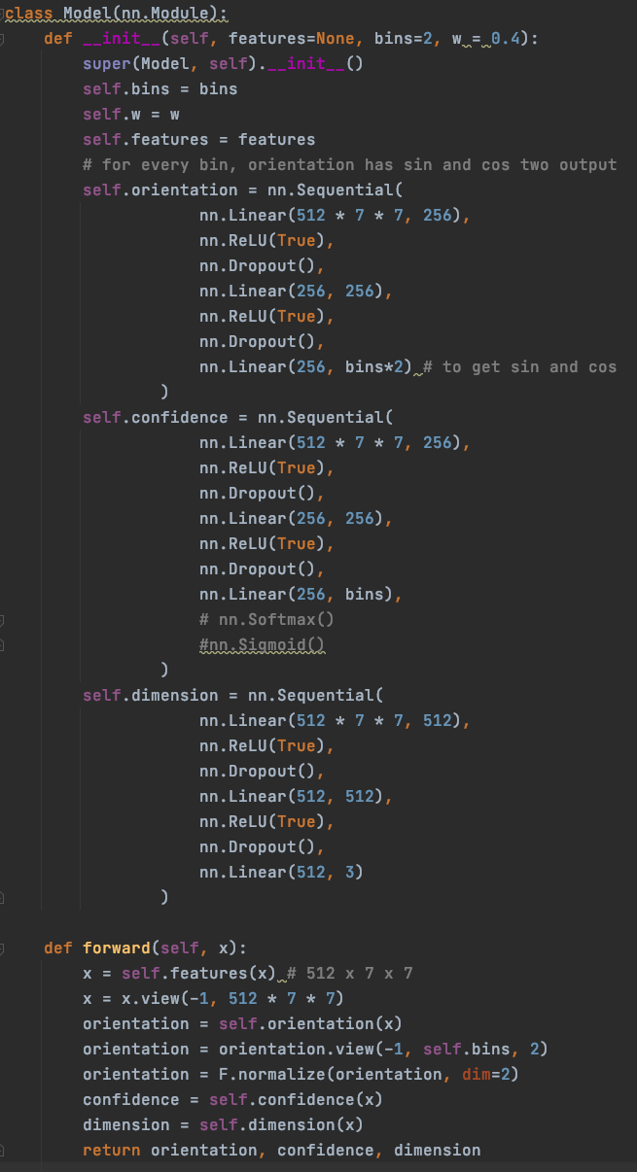
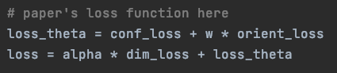
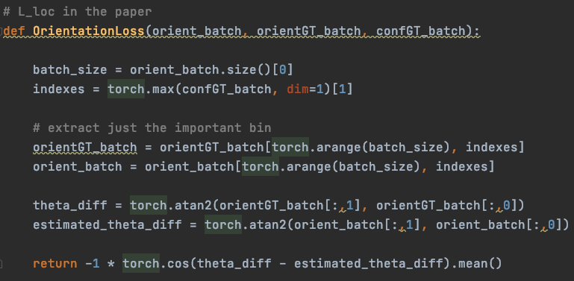
Model

Slide 19
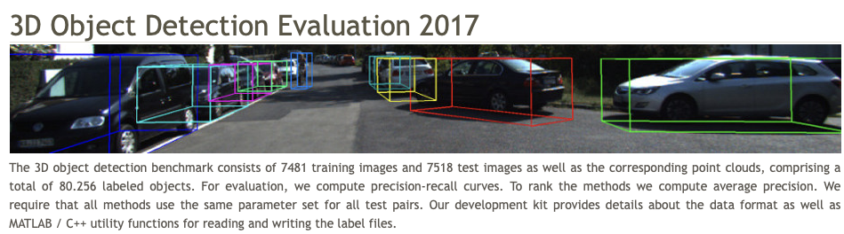
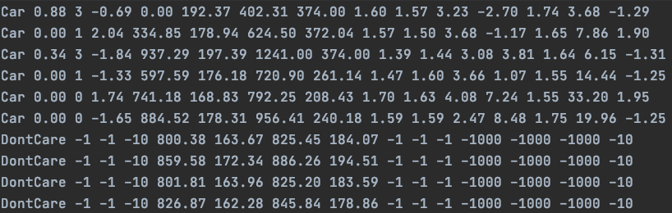
Kitti Dataset
alpha
2D bbox
Dimension
Location
000008 in training set 1242 x 375

Slide 20
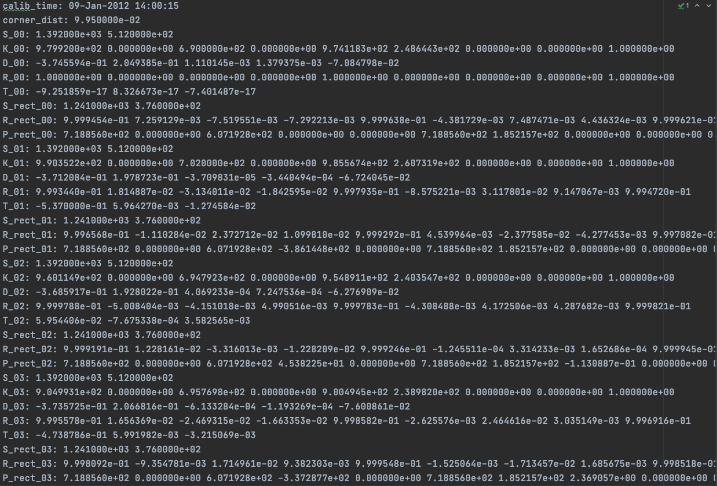
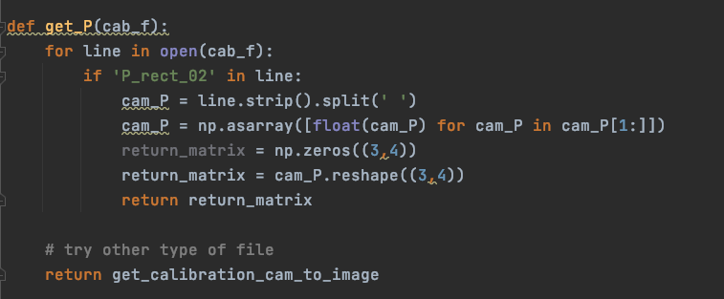
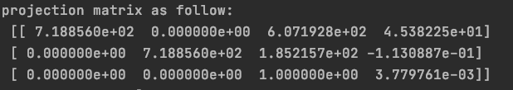
Kitti Dataset camera calibration
3 x 4

Slide 21
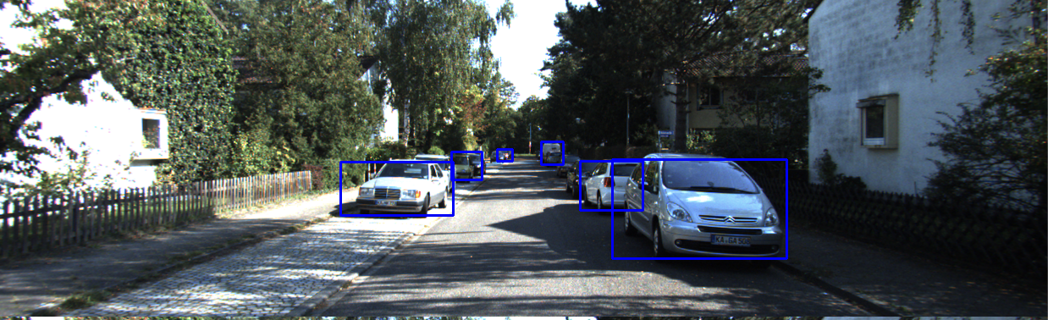
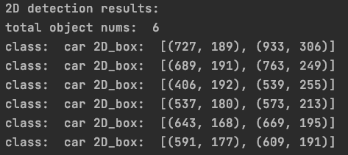
Take an example 2D Detector

Slide 22
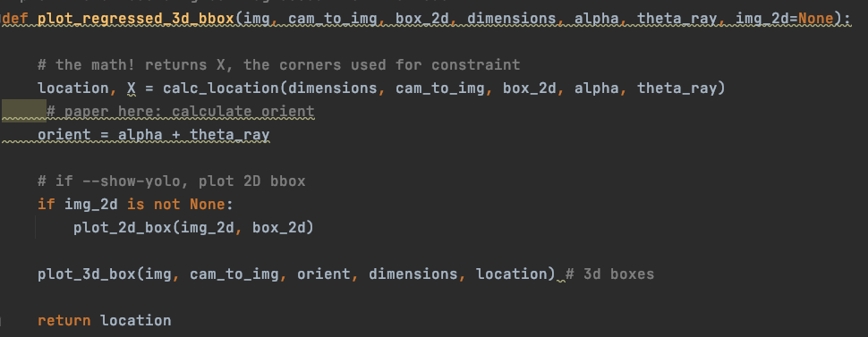
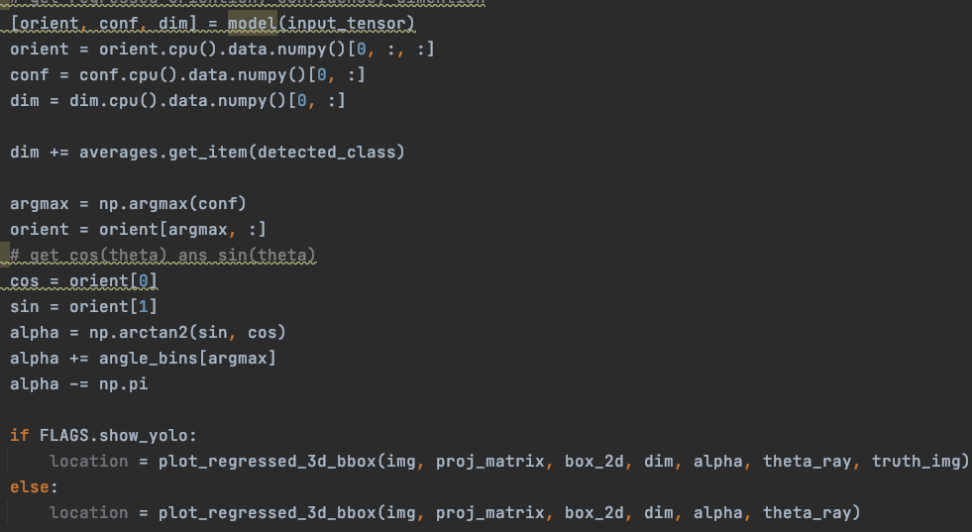
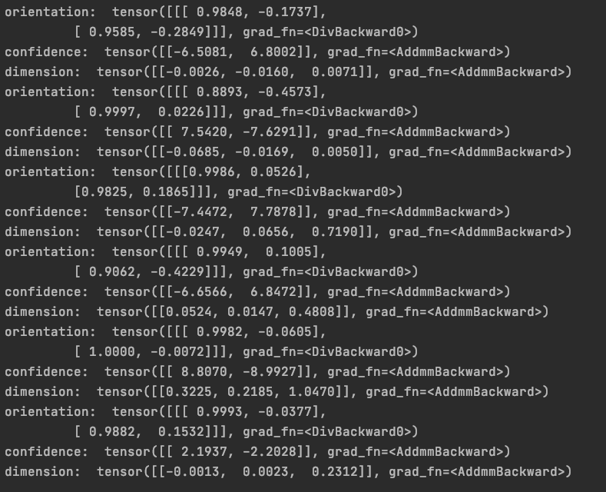
Take an example Regression

Slide 23
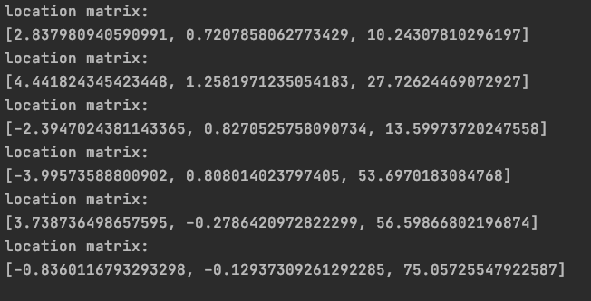
Take an example 3D decoder

Slide 24
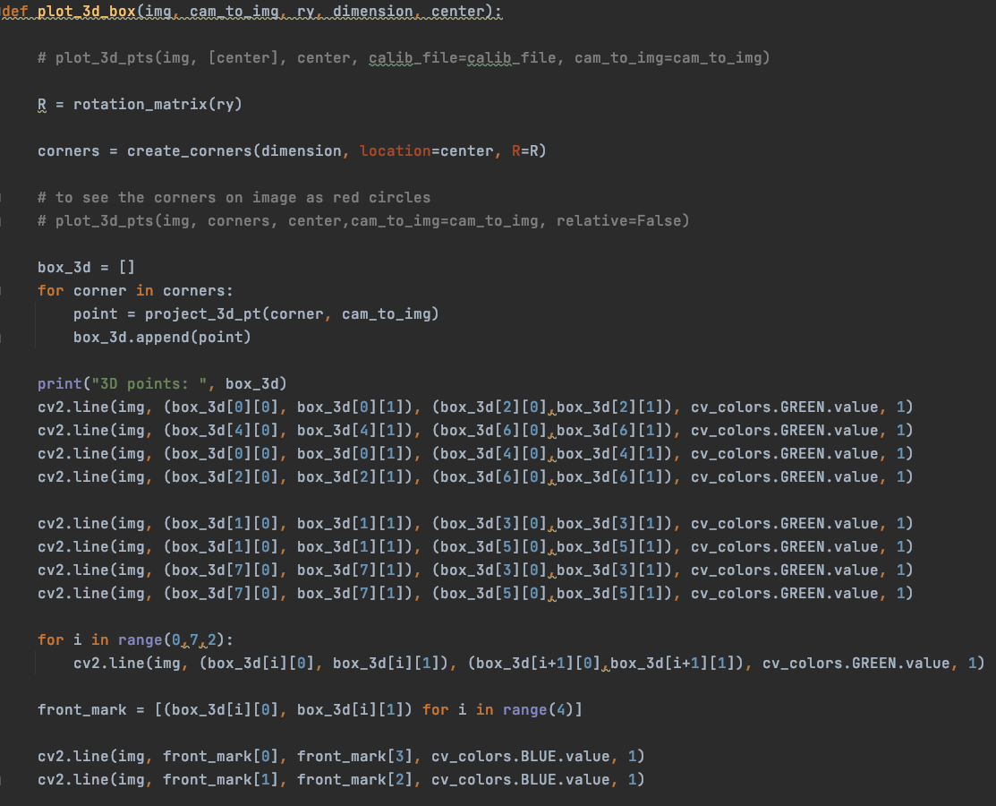
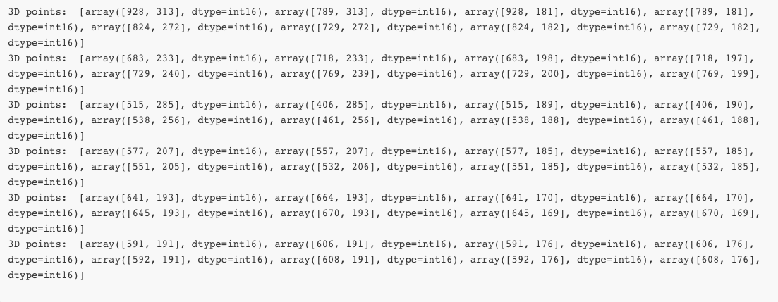
Take an example Plotting

Slide 25
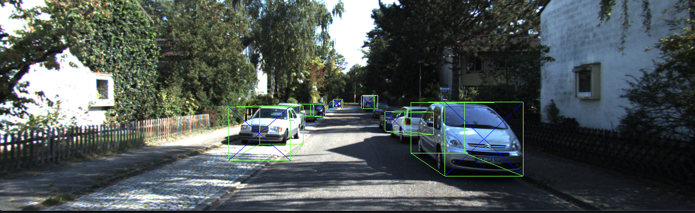
Take an example Plotting

Slide 26
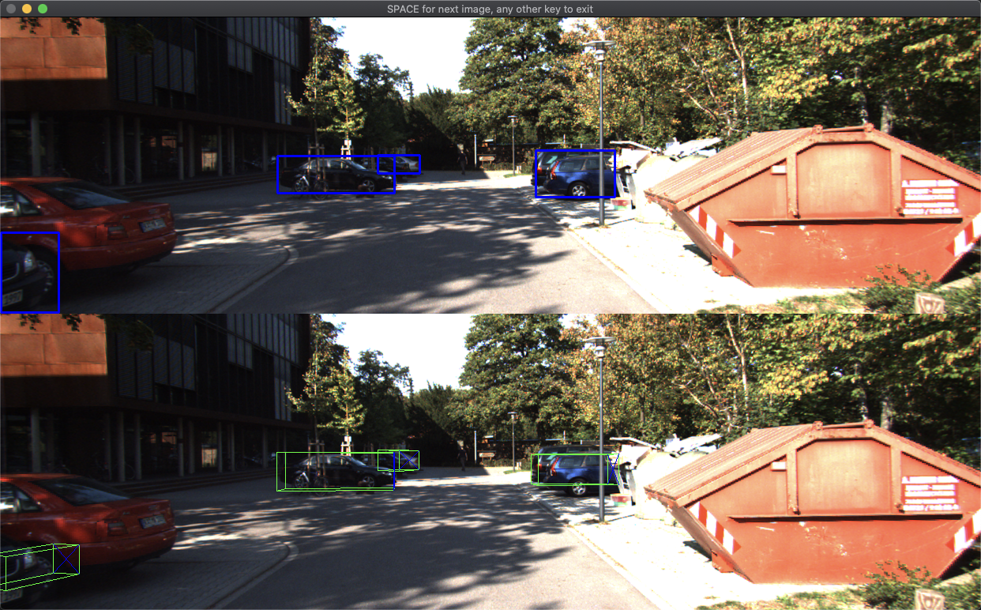
Some evaluations(train set)

Slide 27
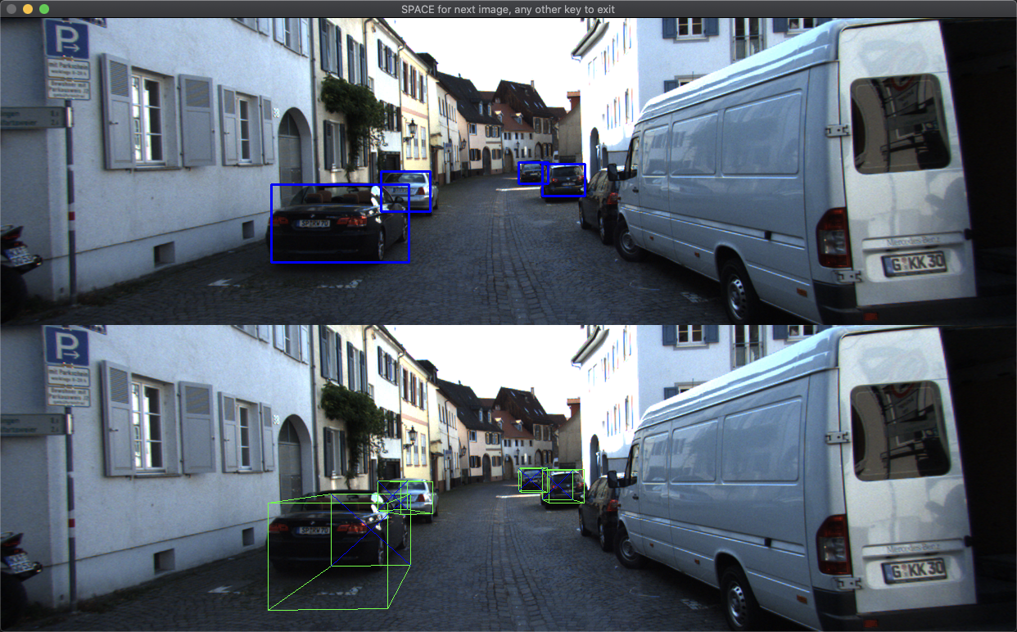
Some evaluations(train set)

Slide 28
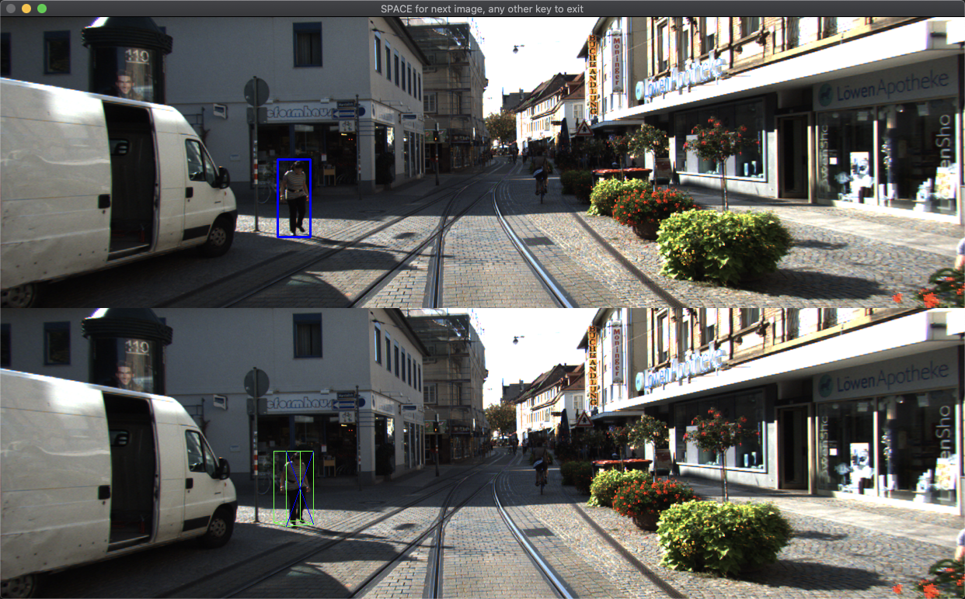
Some evaluations(train set)

Slide 29
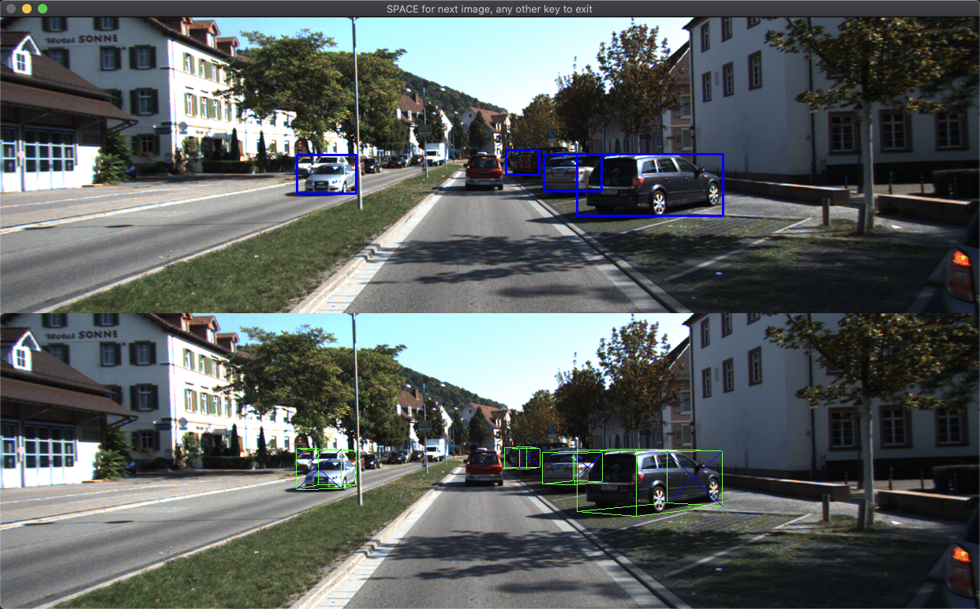
Some evaluations(train set)

Slide 30
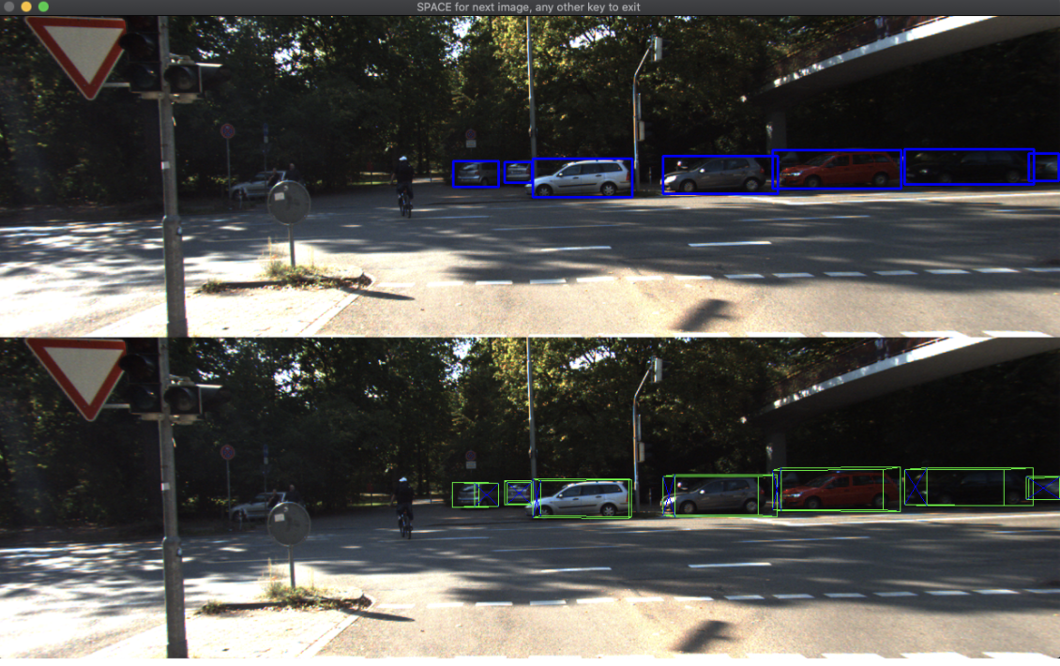
Some evaluations(test set)

Slide 31
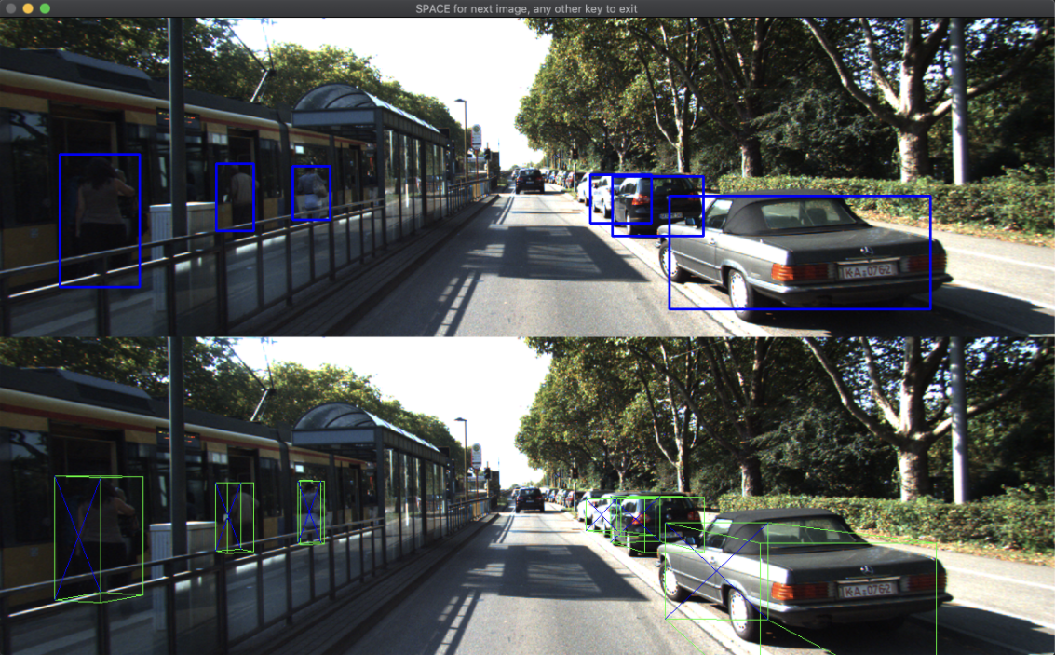
Some evaluations(test set)

Slide 32
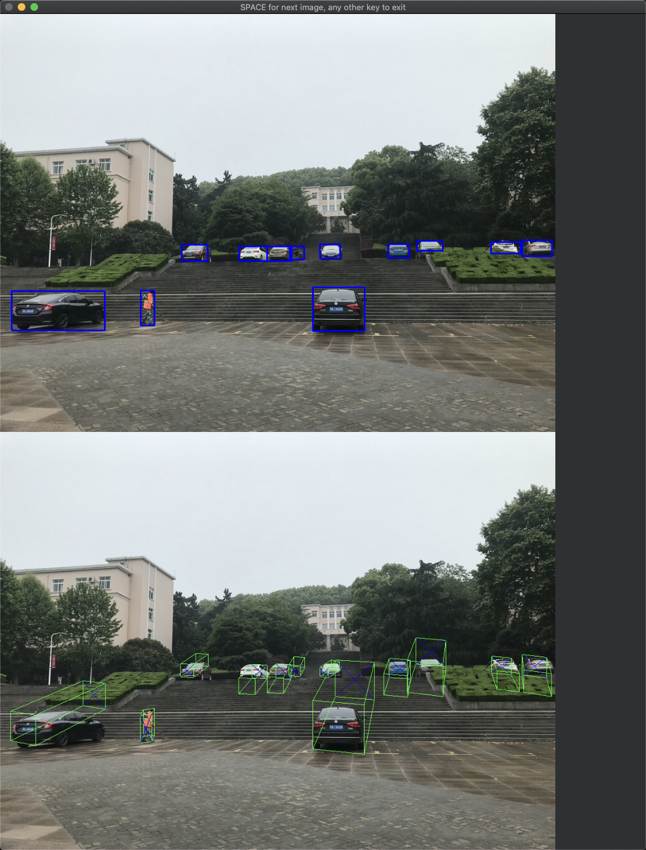
Some evaluations (pictured by myself)

Slide 33
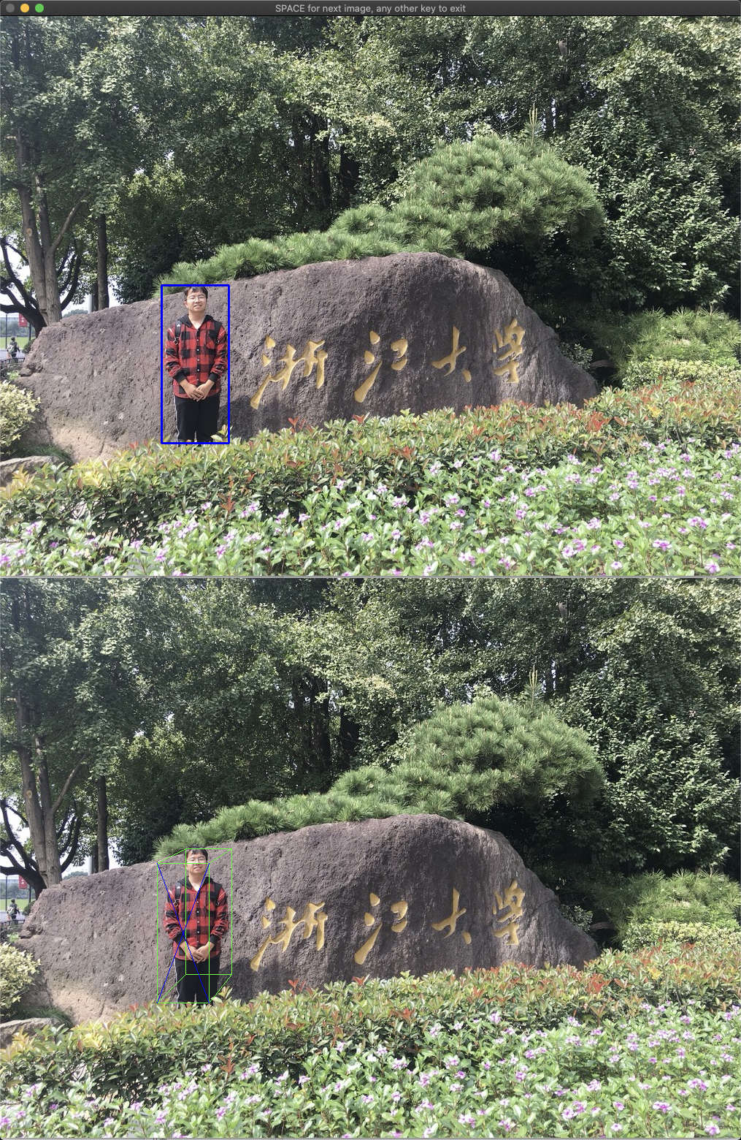
Some evaluations (pictured by myself)

Slide 34
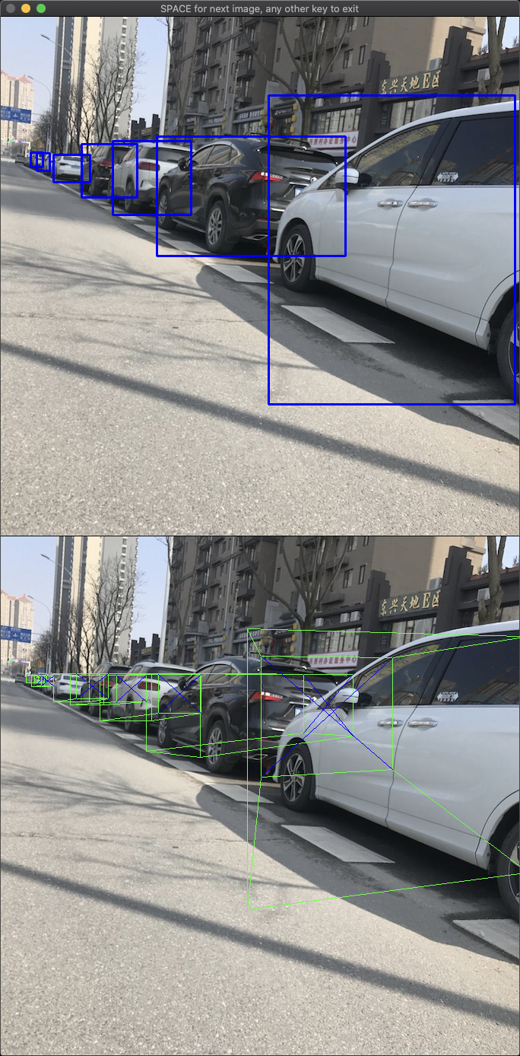
Some evaluations (pictured by myself)

Slide 35

Some evaluations(pictured by myself)

Slide 36

Some evaluations(video)

Slide 37
Conclusions & Further work
More data
Unsupervised or semi-supervised
- video 3D box estimation
Difficulties
Importance of theory
New tech not far away
Acquisition

Slide 38
THANK YOU

